Slide 1

Introduction to Python - Part 3
Python Flow Control

Slide 2
Python Flow Control
Any program has a flow and the flow is the order in which the program’s code executes. The control flow of a Python program is controlled by:
1. Conditional Statements
2. Loops
3. Function Calls
We cover the basics of conditional statements and loops in today’s session

Slide 3
Conditional Statements

Slide 4
The if-statement
The if statement is used in Python for decision making
It is written by using the if keyword
The if keyword is followed by condition later followed by indented block of code which will be executed only if the condition is true
Syntax:
if (condition):
statement(s)

Slide 5
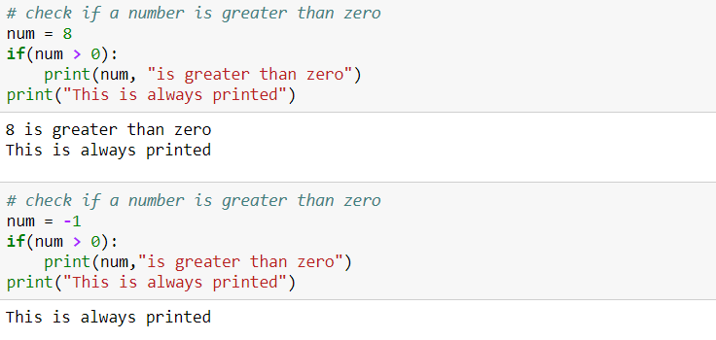
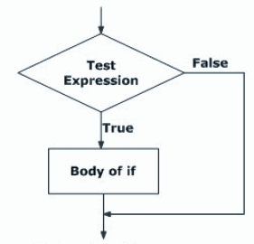
The if-statement
Example:

Slide 6
The if-else statement
The ‘if..else’ statement evaluates a test expression and will execute:
the indented if block of code if the condition is True
the indented else block of code if the condition in the if statement is False
Syntax:
if (condition):
Body of if
else:
Body of else

Slide 7
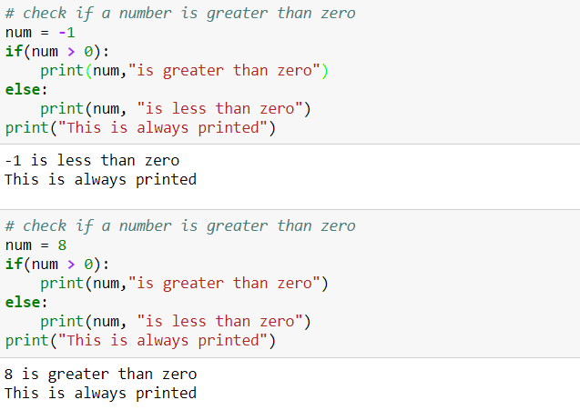
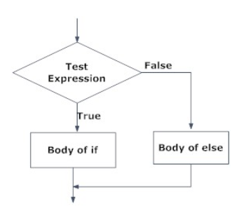
The if-else statement
Example:

Slide 8
If elif else statement
Elif statement is used to control multiple conditions only if the given if condition false
Syntax:
if (condition1):
Body of if
elif (condition2):
Body of elif
elif (condition3):
Body of elif
.
.
.
else:
Body of else

Slide 9
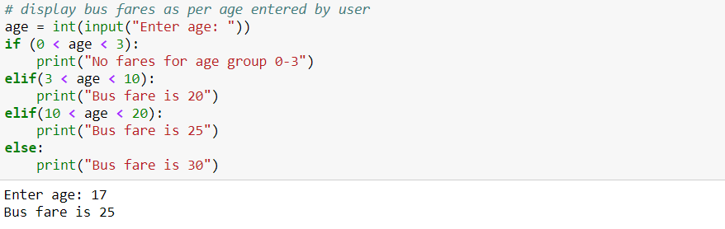
If elif else statement
Example:

Slide 10
Nested If-else statement
Nesting means using an if statement within another if statement
If the first ‘if’ condition is satisfied then the program executes the commands within that ‘if’
Syntax:
if (condition):
statement(s)
if (condition):
statement(s)
else:
statement(s)
else:
statement(s)

Slide 11
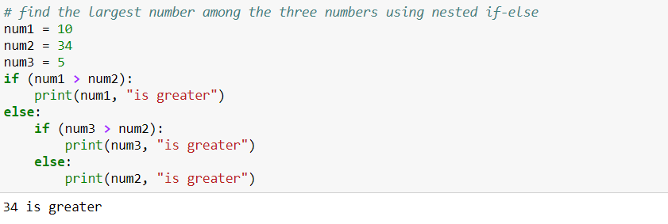
Nested If-else statement
Example:

Slide 12
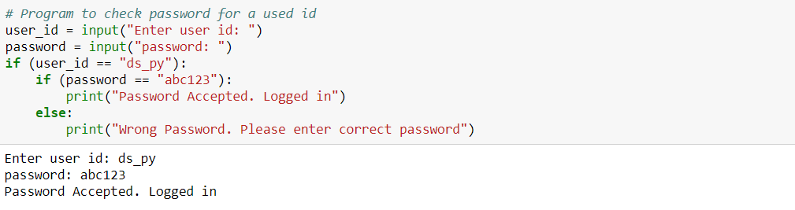
Nested If statement
Example:

Slide 13
Loops

Slide 14
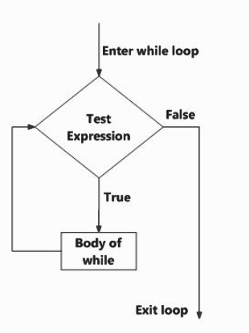
while loop
Loops are used to execute of a specific block of code in repetitively
The ‘while loop’ in Python is used to iterate over a block of code as long as the test expression holds true
This loop is used when the number of times to iterate is not known to us beforehand
Syntax:
while (condition):
Body of while

Slide 15
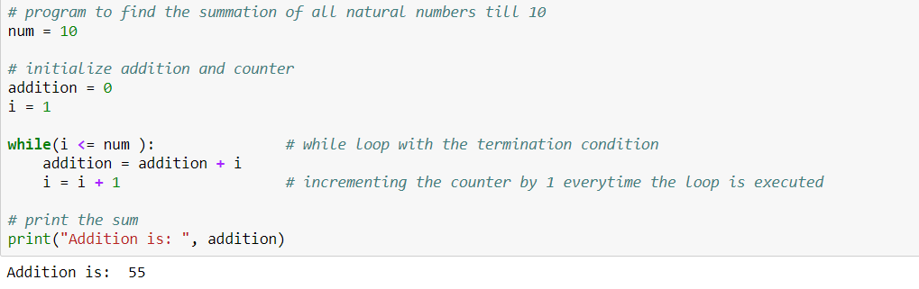
while loop
Example:

Slide 16
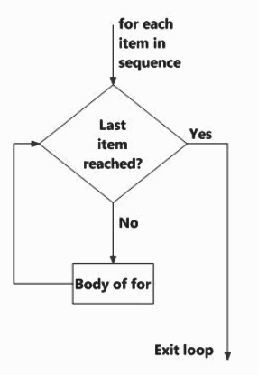
The for Loop
The ‘for loop’ in Python is used to iterate over the items of a sequence object like list, tuple, string and other iterable objects
The iteration continues until we reach the last item in the sequence object
Syntax:
for i in sequence:
Body of for

Slide 17
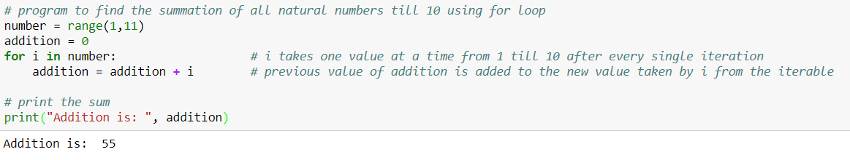
The for Loop
Example:
Iteration is a general term for taking each item from a sequence one after another

Slide 18
Break, Continue

Slide 19
Getting out of a loop
Loops in Python allows us to repeat tasks
But at times, you may want to:
Exit a loop completely when a certain condition is triggered
Skip part of a loop and start next execution

Slide 20
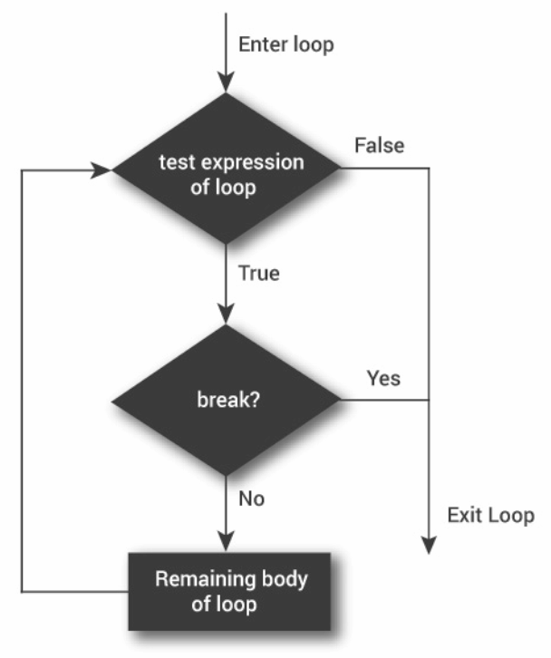
Getting out of a loop with break statement
The ‘break’ statement ends the loop and resumes execution at the next statement
The break statement can be used in both ‘while’ loop and ‘for’ loop
It is always used with conditional statements

Slide 21
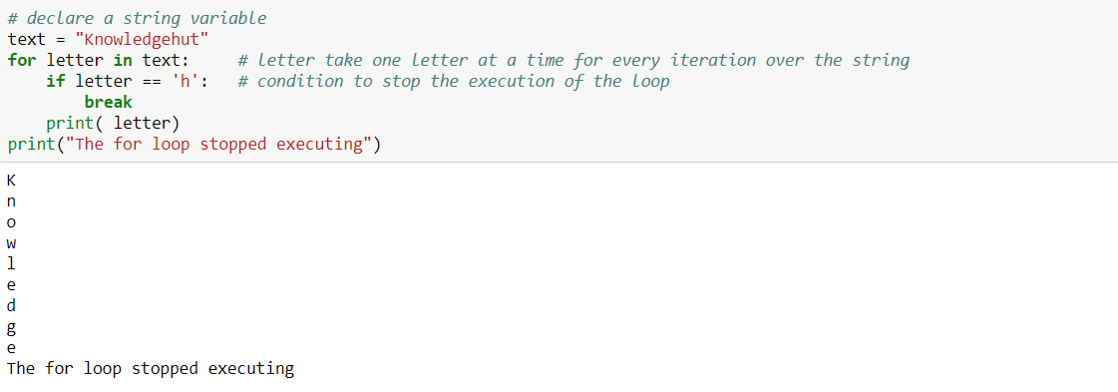
Getting out of a loop with break statement
Example:

Slide 22
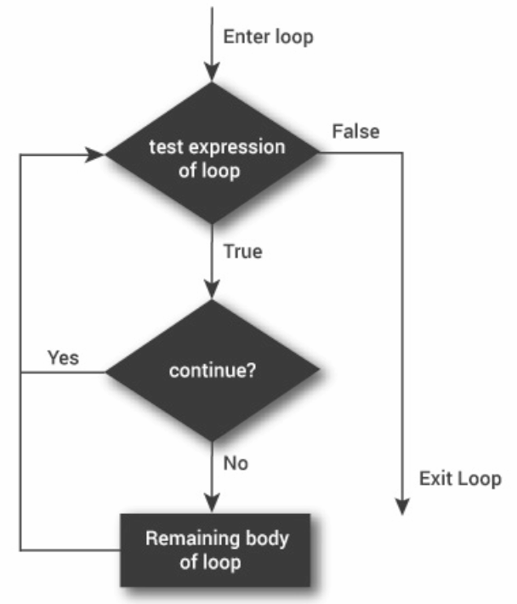
Skip loop step with continue statement
The ‘continue’ statement in Python ignores all the remaining statements in the iteration of the current loop and moves the control back to the beginning of the loop
The continue statement can be used in both ‘while’ loop and the ‘for’ loop
Like break, continue is also always used with conditional statements

Slide 23
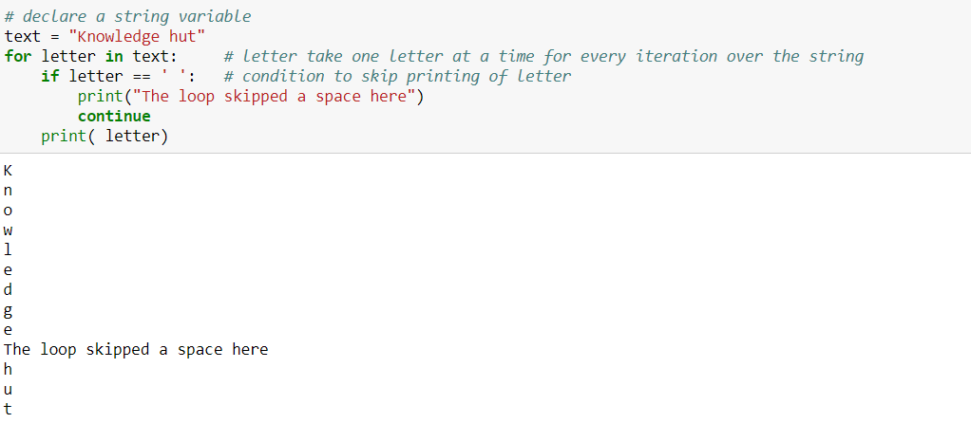
Skip loop step with continue statement
Example:

Slide 24
Nested for loop
1st level loop or outer loop
for [first iterating variable] in [outer loop]:
[code line 1]
[code line 2]
for [second iterating variable] in [nested loop]:
[code line 1]
1st indentation
Nested loop
2nd indentation

Slide 25
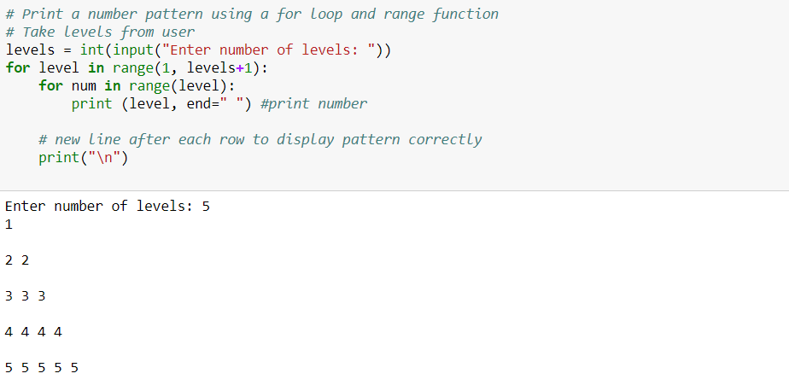
Nested for loop
Outer loop
Inner loop

Slide 26
THANK YOU
Presenter’s Name
Contact Us
support@knowledgehut.com
Presenter’s Designation

